Slide 1




Human Capital Management (HCM)
Product
SAP ERP 6.0 EhP4
Global Bike Inc.
Level
Two
Focus
Human Capital Management (HCM)
Abstract
This teaching material is an introduction into the most important processes concerning Human Capital Management.

Slide 2

Unit Overview
HCM Organizational Structure
HCM Master Data
HCM Processes
  Organizational Management
  Personnel Administration
  Recruitment
  Personnel Development
  Talent Management
  Performancemanagement
  Personnel Controlling

Slide 3







HCM Organizational Structure
Represents the structural and personnel organization of a company
Consists of organizational units
Illustrates the organizational structures and hierarchies
Illustrates an employees responsibilities
Is a precondition of various personnel processes’ implementation
Consists of three parts:
  Enterprise Structure
  Personnel Structure
  Organizational Plan

Slide 4
HCM Enterprise Structure
Enterprise Structure
  Represents formal and financial structures in a company
  Each employee needs to be assigned to an enterprise structure.
  Basically consists of company code, personnel area, and personnel subarea
  Client
    An independent environment in the system
  Company Code
    Smallest org unit for which you can maintain a legal set of books
  Personnel Area
    Represents a company area differentiated between personnel administrative, time management, and expensive organizational aspects
  Personnel Subarea
    Represents part of a personnel area
    Represents a company area differentiated between personnel administration, time management, and payroll accounting aspects

Slide 5
GBI 2.0 Enterprise Structure for HCM
Global Bike Group
Client
Global Bike US
Global Bike Germany
Company
Code
GBI Dallas
GBI Miami
GBI San Diego
GBI Hamburg
GBI Heidelberg
Personnel
Area
Executives
Sales
Sales
Sales
Executives
Finance
Purchasing
Finance
Purchasing
MM
HR
HR
Personnel
Subarea
MM
MM
IT
MM
MM
Purchasing
Purchasing
Production
Production

Slide 6
HCM Personnel Structure
Personnel Structure
  Describes an employee’s position within the company
  Is defined by employee group and employee subgroup
  Employee Group
    Organizational unit for which personnel related regulations can be specified
    Examples:
      Active employees
      External
      Retirees
  Employee Subgroup
    Organizational unit within the employee group, for which personnel related regulations are specified
    Examples:
      Industrial employees
      Commercial clerks
      Laboratory assistants

Slide 7



HCM Personnel Structure
Employee Group
Active
External
Retiree
Employee
Internal
Trainee
Employee Subgroup

Slide 8
HCM Organizational Plan
Organizational Plan
  Describes in which function an employee is acting
  Organizational Unit
    Can be grouped according to functional and regional aspects.
  Position
    Are assigned to organizational units and filled by employees
    Example: Position accounting clerk in the Accounting Department
  Person
    Are employees and fill positions
  Cost Center
    originate from Controlling and can be linked with positions or organizational units
  Job
    General description of tasks which an employee should perform
    Are assigned to positions
    Example: Position Head of Department

Slide 9
HCM Organizational Plan
Cost Center
Organizational Unit
Position
Job
Person
Assignment
Assignment (optional)

Slide 10

HCM Master Data
Personnel number
  Is used in SAP as a central identifier for an employee
  Can comprise by up to eight digits
  Can be assigned either by the system or manually
  All employee data available in the system are identified on the basis of the personnel number.
Personnel no.
64751511
Expenses results
Travel expenses
Expenses
May 2010
Expenses
June 2010
Travel expenses
April 2010

Slide 11
HCM Master Data
Reference Personnel Number
  Helps to map different contractual relationships
  Creates an existing employee newly in the system with a new personnel number
  The old personnel number serves as a reference personnel number.
  Certain data can be copied and assigned to the new number.
  In the case of concurrent employment, the employee is identified through a person ID.
Person ID
155486211
Reference
Personnel number
64751511
Personnel number
47116550
Employee in
personnel area
DL00 Dallas
Project Manager in
personnel area
MI00 Miami

Slide 12

HCM Master Data
Infotypes
  HR master data are structured in infotypes.
  Collections of data fields that are logically linked
  To process employee data in an effective structure in accordance with business requirements
  Each infotype has an explicit four-digit ID, e.g. infotype Addresses 0006.
  An infotype can have sub types, which represent a sub variant of the infotype.
Sub type 0100
Vacation
Infotype 2001
Absence
Sub type 0220
Health resort
Sub type 0601
Parental leave

Slide 13
Time Constraints of Infotypes
Time constraint 1 e.g. permanent residence
Time constraint 2 e.g. husband
Time constraint 3 e.g. secondary residence

Slide 14
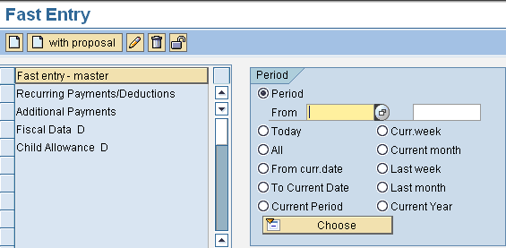





Maintenance of Infotype
Infotypes can be maintained in three different ways:
Fast entry
Single infotype maintenance
Personnel action

Slide 15
Roles
HR Administrator
Personnel Development Manager
Head of Department
Time Management
Personnel Development
Talent Management
Travel Management
Payroll
Personnel Controlling
Recruitment
Performancemanagement
Travel Administrator
Time Administrator
Billing Clerk

Slide 16





HCM Processes - Organizational Management
  Model the organizational structure of your enterprise
  Create, change and delimit organizational units
  Create, change and delimit jobs
  Create, change and delimit positions
  Analyze an organizational unit to define
  workforce requirements and personnel cost planning
  Create further organizational units for planning
  scenarios or simulations

Slide 17

HCM Processes - Personnel Administration
  Creating and maintaining personnel master data
  Plausibility checks
    may be performed to detect errors
    prevent the transfer of incorrect data
  Automatic history
    is created when changing master data
    may be used for reporting and the verification of data integrity
  Personnel administration sets the data basis for subsequent processes in Human Resource Management and reporting

Slide 18

HCM Processes - Recruitment
Recruitment, choice and setting of applicants
External recruitment
Internal recruitment
Developing a data base for applicants
Administration of vacant positions
Notes:
The challenge of recruitment is to recruit a number of personnel at a certain point in time with all the needed qualifications at an adequate effort.
In general, there are two different ways of recruitment. Within external recruitment, people are searching on an external market for adequate personnel. On the other hand, there is internal recruitment. The internal way looks for personnel within the company for a certain position. If applicable, a transfer is accomplished.
The goal of recruitment in SAP HCM is supporting the HR department in searching, choosing and recruiting adequate applicants. At the same time, the HR department gets support in building up an applicants data base. If there exists a requirement for new personnel, the data base can be used. Because of the fact, that applicants normally choose to make a bit on free positions, the administration of those positions is part of recruitment, too.

Slide 19
Recruitment - Organizational Assignment
Applicants are assigned to the elements of the applicant structure:
Applicant Group
Structures applicants according to the type of their employment relationship
Actives
Working students
Applicant Range
Employees
Leading employees
Specialist
Classifies applicants according to hierarchical or functional criteria
Notes:
There exist similar structures in recruitment and personnel administration concerning the organizational allocation of applicants. These are used for steering and evaluation related functions. The allocation of applicants to the company via the personnel area and personnel subarea takes place already when doing the first data entry. The complement of employee structure out of the personnel administration describes the applicant structure in recruitment. It is determined by the following elements.
Applicant group: Similar to the employee group, the applicant group is scaled into actives, working students etc.
Applicant range: The applicant range guarantees a better differentiation of the applicants. Normally, it arranges applicants due to functional or hierarchical criteria, for example employees, managers, corporate management, production, etc.

Slide 20
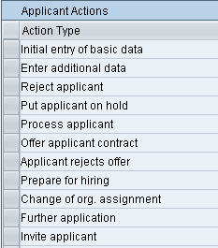
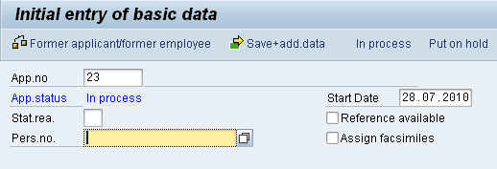
Recruitment - Applicant Data
Maintaining applicant data can be done in infotypes with the help of the Initial Data Entry or Application Actions
Applicant action
Initial Data Entry
Notes:
Recruitment in SAP has similar characteristics as personnel administration. Maintaining applicant data takes place in infotypes. Moreover, every applicant has its own applicant number. With internal application, the personnel number from personnel administration can be used as the applicant number. Applicant data is saved separately within the employee data of a company. The complement of personnel action in personnel administration is the applicant action.
Applicant actions can be linked with applicant activities. These are administrative steps that have to be fulfilled within an application. Through customizing, applicant activities are included in applicant actions (e.g. applicant activity entry confirmation). This applicant activity is recognized after the entry confirmation of the applicant action.
All activities of a certain applicant have to be journalized. By doing so, the course of an applicant is followed in the system easily.

Slide 21
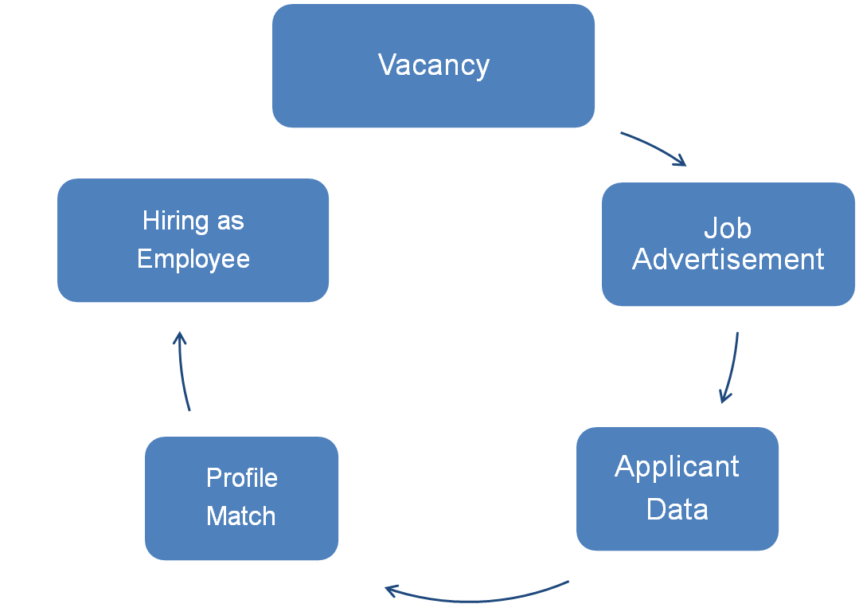
Recruitment - Process

Slide 22


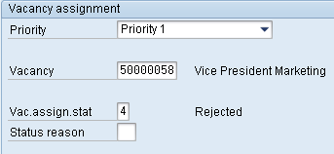
Recruitment - Selection Procedures
In SAP HCM, two types of selection procedures are distinguished:
Global Selection Procedure
Selection Procedure for each Vacancy
Overall status
Status of vacancy assignment
Notes:
In SAP HCM there is a differentiation in two kinds of selection procedures. Every applicant has two stadiums in selection procedures, which reflect a certain candidacy.
Global selection procedures: Every registered applicant takes part in the selection procedure. A decision is made, if the applicant is of interest for the company. If the applicant is not dismissed, he can take part in the selection procedure for vacancies. The overall status determines the level of the applicant in the global selection procedure.
Selection procedures for every vacancy: Within this selection procedure, the applicant is assigned to special vacancies. The status of vacancy assignment describes the level of the applicant in the selection procedure for a vacancy.
The levels can have the following magnitudes:
developing
to be positioned
deferred
dismissed
treaty offered
offer disclaimed
invited
A reason can be added to the status of an applicant to enhance the informational character of a level.

Slide 23
HCM Processes - Personnel Development
Advance qualifications of employees
Comparison: requirements of positions with qualifications of employees → profile matchup
identify further training need
Introduce development actions → Talent Management
Book training course → Training and Event Management
Arrange appraisals→ Performance Management
Notes:
The goal of personnel development is to qualify employees for actual and future requirements and to maximize the benefits of employees this way. The requirement of personnel development in a company results from the comparison of actual and future requirements.
A personnel development system supports the HR department with planning and administration of teaching and development actions. Furthermore it enables to care for qualifications of employees and to show deficits in qualifications of employees. To assure this, the requirements of a positions or job are compared to the qualifications of employees within a profile matchup. Out of qualification deficits a personnel development system can generate development proposals and plans. Moreover, employees can be booked directly for training courses or other events. After a training course or a development action, acquired qualifications are absorbed to the qualification profile of an employee from the personnel development system. In performance management, benefits and developments of employees can be evaluated.

Slide 24
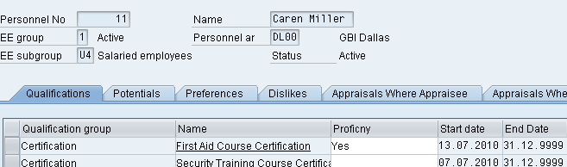
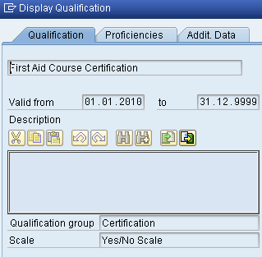
Personnel Development - Qualifications
Qualifications can be connected to persons
Need to be attached with attributes
Can have a half-life period or a validity period
Notes:
Qualifications can be linked with persons or positions. The last is not called a qualification but a requirement. If a qualification is linked with a person or a position, it has to be created with characteristics. These characteristics can be createad with quality scales. Any quality scales can be defined, for example a school grade system from 1-6 or a Yes/No system. Every qualification group has a certain quality scale which is later passed to the qualifications of the qualification group.
Qualifications can be assigned to a half-life period. By using the half-life period, it is possible to simulate, that qualifications can be forgotten or unlearned. For example, the language knowledge of an employee are getting worse every five years if he/she does not visit advanced training courses during this period. Qualifications can be provided with a validity period to show the decline of qualifications at a point in time. A given example is a first aid course, in which somebody has to take part every two years.
Furthermore a qualification can be denoted as an alternative qualification of another qualification. A percentage can describe how much a qualification could replace another one. An example for illustration. You did two first aid courses in the qualification catalogue. The first course takes time of two weekends whereas the second course took place at one weekend. The second course can be an alternative qualification related to the first course at a percentage of 50%.
Every employee has a profile in SAP. This profile includes for example qualifications, interests, potential and aversions.

Slide 25
Personnel Development - Qualifications Catalog
Qualifications are defined in the qualifications catalog
It can be maintained in Customizing
The structure may consist of qualification groups, classifying similar qualifications
Catalog
IT knowledge
Health and Security
Operating system
Data base
System
Modelling
First aid
knowledge
Work
security
Windows 95
Linux
Qualification group
Qualification
Notes:
In SAP qualifications are defined in the qualifications catalog. The qualifications catalog can be executed in customizing in personnel development. To structure the qualifications catalog, qualification groups can be used where similar qualifications are grouped together.

Slide 26
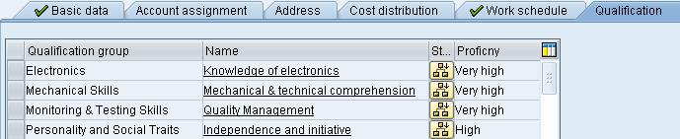
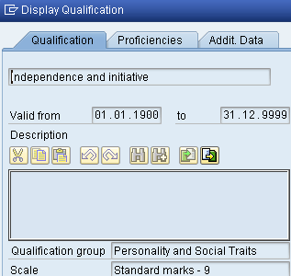
Personnel Development - Requirements
Requirements can be attached to positions
Requirements are qualifications, knowledge and experiences
Requirements can be created with a characteristic
Notes:
To implement the profile matchup, requirements for a position or a job, which a person should have take over a position, have to be created. Requirements are mostly determined by certain qualifications, abilities and experiences for example knowledge in Software, Soft-Skills, expertise or physical ability. These requirements can be provided when creating a position and they can be evaluated with the belonging characteristics.

Slide 27
Personnel Development - Profile Matchup
With the help of the profile matchup, persons, positions and jobs can be compared to each other
The difference between the characteristic of a requirement and the characteristic of a qualification is determined
3 results are possible:
  Both characteristics are identical
  The requirements are higher than the qualification (=underqualification)
  The requirements are lower than the qualification (=overqualification)
Position
Person
Requirements
Qualification
Notes:
Through the profile matchup persons, positions and jobs can be compared with each other. The profile matchup determines the difference of the characteristic of a requirements and the characteristic of a qualification. Three different solutions are possible:
Both characteristics are identical
The requirement is higher than the qualification (= underqualification)
The requirement is less than the qualification (= overqualification)
If there exists underqualification (at integration with training and event management), training courses are suggested to get rid of the qualification deficit.
Business events are fostered in the system business event menu. It is possible to allocate qualifications with certain proficiencies to business events. This way, the qualification is added to the profile of an employee at the exact proficiency after visiting the business event.

Slide 28
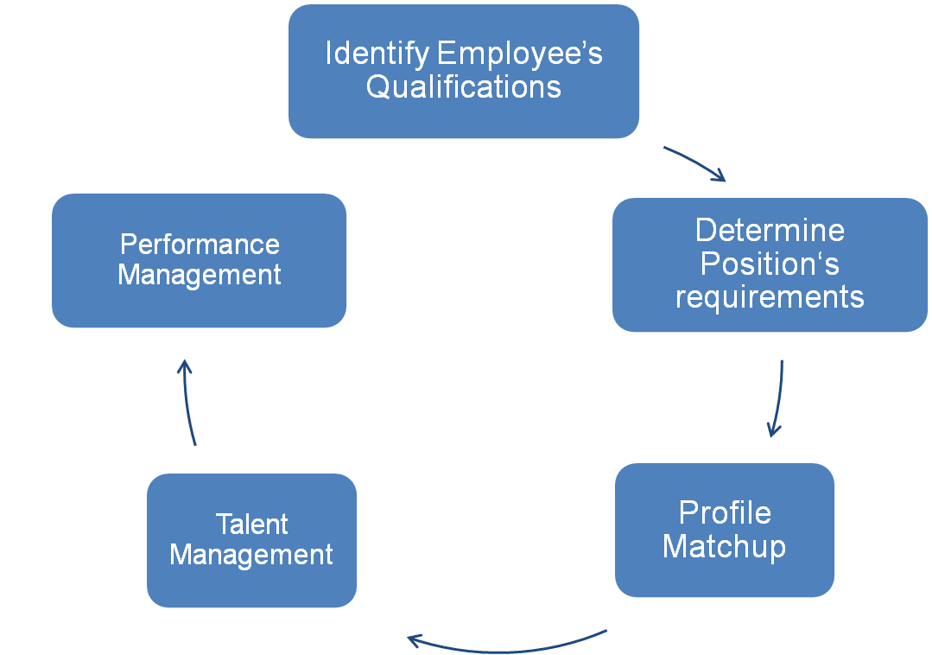
Personnel Development - Process

Slide 29

HCM Processes - Talent Management
Arrange Career Planning
Accomplish Succession Planning
Generate general Development Plans
Generate individual Development Plans
Notes:
The talent management is concerned with career planning as well as further training of employees and is integrated in personnel planning. Firstly, the talent management includes analyzing and applying of careers, individual development plans and following plans.

Slide 30
Talent Management - Career Planning
Identify career goals
Plan career
Define and develop special stations of a career
  job
  position
  Course of instruction
Career planning: comparing qualifications with requirements of one station of a career, e.g. job, position → Personnel decisions, courses of instruction, etc.
Derivate individual plans
Notes:
In career planning it is possible to allocate concrete positions and tasks for an employee, that he/she should fulfill during his career in the company. Relating to this, development actions are derivated, which are important for the employee to reach a station. This is arranged when qualifications of an employee get adjusted with requirements of a station in the career. The career of employees is planned and transcribed this way and development possibilities are made up. Individual development plans get derivated out of the findings from career planning afterwards.

Slide 31
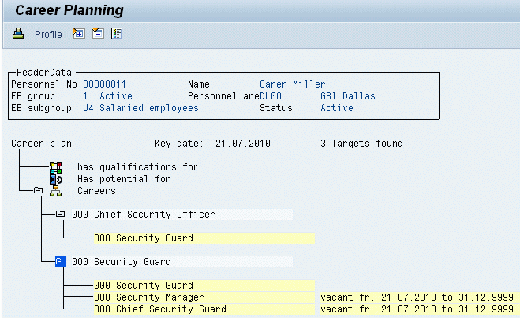
Talent Management - Career Planning (cont.)
Example for Career Planning

Slide 32

Talent Management - Succession Planning
Assure continuity in personnel allocation for key positions
Per-active search for candidates to reallocate key positions
Well-directed preparation on adoption of following job
Notes:
Succession planning shall help to ensure continuity of personnel availability of key positions in a company. The search for adequate candidates is carried out pre-active. If an adequate candidate is found, this one can be prepared for the transfer to the following job. Development actions and individual development plans help to do so.

Slide 33

Talent Management - Development Plans
Summarizing teaching and further education actions to procure special qualifications
Participation in instruction courses
Allocation of positions
Use in an organizational unit
Habitation in a location
Notes:
Development plans describe a summary of further training and general training events, that an employee can use in the career. A differentiation exists between general and individual development plans. General development plans are guideline for several employee whereas individual development plans are developed for a special employee.

Slide 34
HCM Processes - Performance Management
Define objective setting between enterprise and employees
Evaluate benefit of employees → Feedback
→ Have goals been achieved?
Supervise operative goals of employees
Adjust rebates
Goal: higher motivation and better benefits
Notes:
Performance management in SAP controls and constructs performance appraisals and/or objective settings between company and employees. Objective settings can mark the enterprise structure down to the employee level. The appraisal results are foundation for eventually happening compensation adjustments. Goal of performance management is higher motivation and a better benefit of employees.

Slide 35
Performance Management - Process of Appraisal
Planning
Agree on goals
Feedback
Perform Appraisal
Compensation
Adjustment
Notes:
Performance management in SAP supports the continuous performance feedback process. Three components are part of this process: planning, appraisal and compensation adjustments. Within the planning of appraisals, enterprise as well as individual goals are set between employee and management. In the following, a feedback is given, which evaluates the benefit of the employees in relation to the expected goals. Individual and group appraisals can be realized as well as 360° feedbacks. Development events and compensation adjustments are dervided out of the findings.

Slide 36


Performance Management - Status
In order to display a performance feedback process, appraisals and objective settings may have different statuses.
  In Preparation: an appraisal template has been created and provided with header data (e.g. appraiser, validity)
  In Process: an appraisal has been given but it is not completed, the evaluation may still be changed
  Completed: The appraisal is finished
  Approved: The appraisal has been approved
  Rejected: the appraisal has been rejected

Slide 37
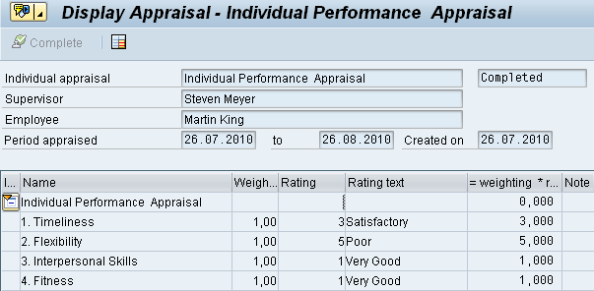
Performance Management - Appraisal Template
The Appraisal Template comprises different elements:
  Formulas
  Criteria groups
  Criteria
  Qualifications
Notes:
Performance management offers different approval processes for different kinds of approval, for example sub-appraisals or 360° feedback. In performance management, appraisal templates are created and deposited. To structure the appraisal catalog, appraisal category groups and appraisal categories are spread. This structuring can include so called appraisal elements. Appraisal elements can be appraisal templates, criteria groups, criteria or external elements (e.g. qualifications)
Through the integration with personnel development requirements, profiles or qualifications out of the qualifications catalog can be gathered in objective claims of an employee. After the closure of the appraisal qualification profiles of employees are updated automatically. With the help of integration into event management, event and attendee appraisals are realized. If there exists an integration into the enterprise compensation management, the possibility is offered, to realize performance related compensation adjustments. Here, the appraisal of an employee is used to adjust the compensation dynamically.

Slide 38

HCM Processes - Personnel Controlling
Reports and Analysis
Evaluation of personnel data
Standard reports
Human Resource Information System
Manager‘s Desktop
Ad-hoc Query
Business Intelligence
Notes:
Personnel Controlling enables the creation of reports out of a flood of data within Human Resource Management. Data needed for a report can arise from single or several Human Resource processes. SAP HCM enables a simple creation or reports and analysis for evaluating certain data. Therefore, simple employee lists as well as complex business calculations are provided. Personnel controlling within SAP HCM facilitates the creation of cyclic reports as well as the spontaneous report request. Moreover, reports can be compared with each other and a forecast for the future can be generated on the basis of a report.
In SAP the following tools can be used in personnel controlling and will be described in the following slides:
Standard reports
Human Resource Information System (HIS)
Manager’s Desktop
Ad-hoc Query
Business Intelligence

Slide 39
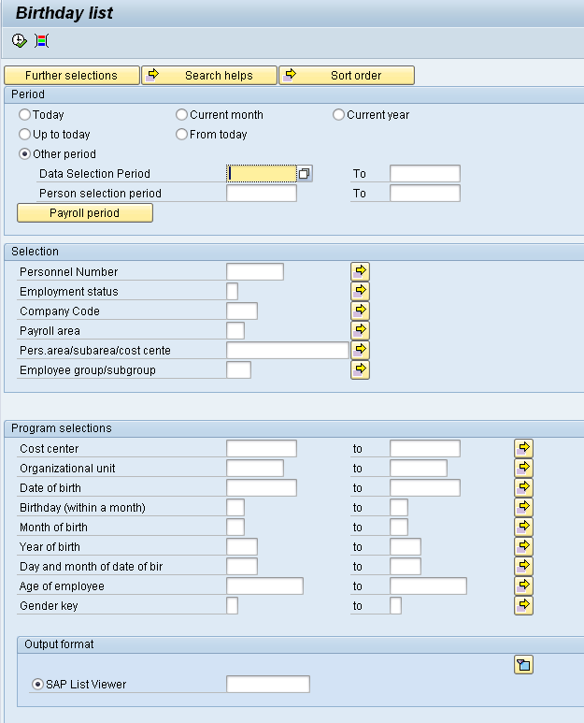
Personnel Controlling - Standard Reports
= predefined SAP requests with a unique design
Example: Birthday List
Notes:
Standard reports are pre-defined SAP requests which are directly triggers from the Easy Access Menu. They can be found in the folder Information System in the Easy Access Menu or within a component of this folder. Standard reports are for instance employee lists, birthday lists, etc. These reports are related to persons and their structure is consistent. When starting a standard report a display for data selection opens in which several choice boxes are available. Standard reports are displayed in a list, which can be dumped in an Excel file for instance. In addition, the output can be displayed graphically.
The entry screen for creating a standard report is divided into several areas. In the area period, a period can be chosen about which the report shall be generated. In the area selection, the reports can be limited to specific employees or organizational units. With the help of program selections, the report can be limited to specific result areas. Finally, the output format of the report can be chosen.

Slide 40
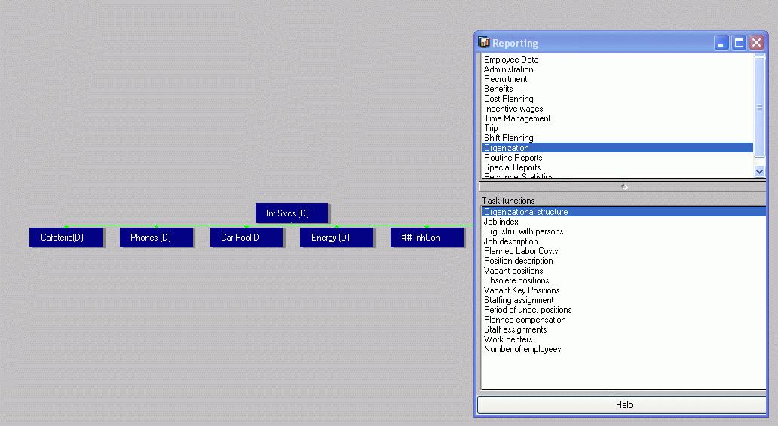
Personnel Controlling - HIS
The Human Resource Information System (HIS) enables the analysis on the basis of the organizational structure.
Notes:
The Human Resource Information System (HIS) enables the evaluation on the basis of the organizational structure. When starting the HIS, an organizational unit needs to be chosen as the starting point. In the initial screen, the organizational structure is displayed in a tree structure based on the chosen starting point. After the selection of the element within the displayed organizational structure, different reports can be chosen. Within the area „Reporting“ different components, which shall be displayed for a specific element, can be chosen. Within the area „Task functions“, the user can see a list of existing standard reports for a component.

Slide 41
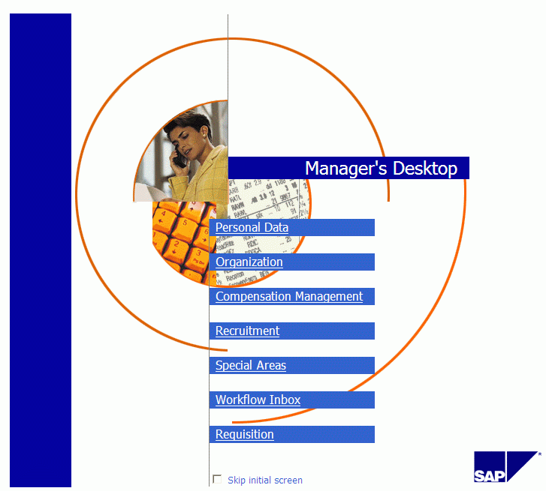
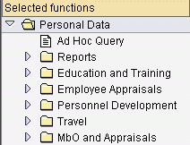
Personnel Controlling - Manager‘s Desktop
Notes:
The Manager’s Desktop (MDT) adresses managers but can also be applied for other executives within an organization. Within the MDT, reports are also created on the basis of the organizational structure. In addition to the reporting functions, the user can access transactions of other HCM module components via the MDT. It is for instance possible to insert decisions within personnel recrutiment into the system via the MDT. With this, the manager does not have to access single transactions via the Easy Access Menu, but simply needs the MDT. The MDT comprises theme categories, like employees, organization, costs & planning etc. For each theme category there is a function list in which different SAP functionalities can be provided for the respective theme categories, among others reports from personnel controlling. The theme categories and function lists can be adapted and changed according to individual needs via customizing.

Slide 42
Personnel Controlling - Ad-hoc Query
Ad-hoc Queries are a tool for analysing data from personnel management
Infoset
Personnel Administration
Payroll
IT 0001
IT 0006
IT 0007
…
Gross result
Optional data
Church tax
…
Choose selection fields
Choose output fields
Export ad-hoc query
Save ad-hoc query
Notes:
With Ad-Hoc Querys, SAP provides its customers an easy to use, though very effective tool. With ad-hoc queries, user-defined reports can be created. The denotation „ad-hoc- query“ is exclusively used within the HCM module. Outside the HCM module, this tool is named „infoset query“.
When creating an ad-hoc query, the user can decide on his or her own which data fields shall be provided as selection criteria for the report. In connection with this, data fields from the different components of the HCM module can be chosen. In addition, the user can chose those data fields, displayed in the output of the report as well as the output form of the report. Ad-hoc querys can be saved and do not have to be regenerated when calling the query. In order to limit the data fields, visible for a user, so-called infosets can be generated in customizing. In these infosets, data fields that are available for users can be defined which when creating ad-hoc queries. The infosets are assigned to a user with the help of a user group.

Slide 43

Personnel Controlling - Business Intelligence
 | SAP ERP | SAP BI
Goal | Implementation of business processes | Analysis, Knowledge generation
Priorities | Availability & data protection | Usability, comprehensive analysis options
Age of data | Updated | historical
Data Processing | Create, edit, delete and display | display
Notes:
With SAP Business Inteligence (BI) comprehensive reports can be created as well. SAP BI is an independent system and is based on a portal technology. With the help of SAP BI, data from SAP systems or from other systems can be integrated. SAP BI provides substantial planning and simulation functions and is especially profitable in case of a high amount of data. Through the data integration from external systems, benchmarking is also possible. The table compares the requirements of an SAP ERP system with those of an SAP BI system.

